Slide 1
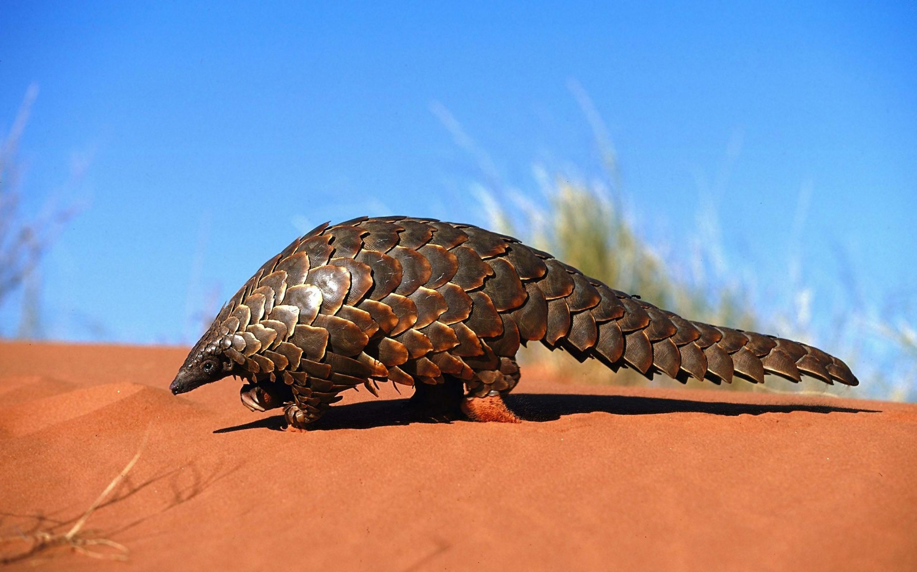
Alpha-taxonomy of world mammals 1975—2017
Ruan van Mazijk

Slide 2
Alpha-taxonomy of world mammals 1975—2017
* sort of
Ruan van Mazijk

Slide 3
Mammal Species of the World, 3rd Edition (MSW3)
1702—2005
It’s something!
D. E. Wilson & D.-A. M.Reeder (eds.). Mammal Species of the World. A Taxonomic and Geographic Reference, 3rd Edition. John Hopkins University Press, Baltimore.
https://www.departments.bucknell.edu/biology/resources/msw3/

Slide 4

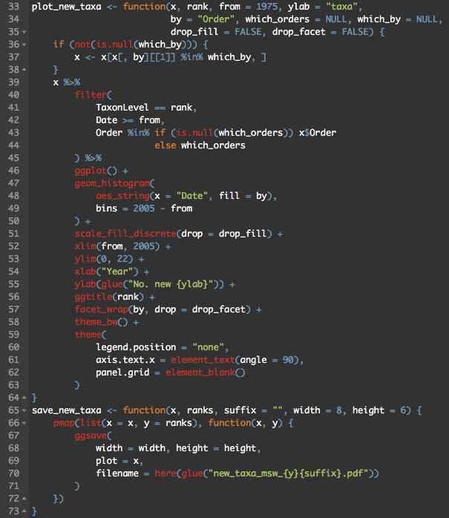
Mammal Species of the World, 3rd Edition (MSW3)
1702—2005
It’s something!

Slide 5
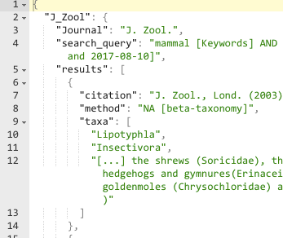
Mammal Species of the World, 3rd Edition (MSW3)
1702—2005
It’s something!

Slide 6
1975—2005

Slide 7
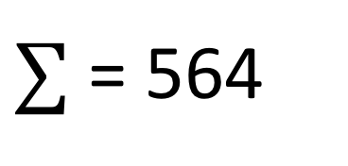
$∑$ = 564

Slide 8
filter(count(new_species) ≥ 10)

Slide 9

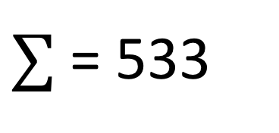
$∑$ = 533

Slide 10
(Tasmanian-devils & numbats)
(Opossums)
(Koalas & wombats)
(Moles & shrews)
$∑$ = 533

Slide 11
(Tasmanian-devils & numbats)
(Opossums)
(Koalas & wombats)
(Moles & shrews)

Slide 13
“Mammalogists, for the most part, have avoided debate on species concepts, but most investigators follow a particular species definition”

Slide 14
“Mammalogists, for the most part, have avoided debate on species concepts, but most investigators follow a particular species definition”
—Baker & Bradley 2006 (J. Mammal. 87(4):643–662)

Slide 15
“Mammalogists, for the most part, have avoided debate on species concepts, but most investigators follow a particular species definition”
—Baker & Bradley 2006 (J. Mammal. 87(4):643–662)

Slide 16
“Mammalogists, for the most part, have avoided debate on species concepts, but most investigators follow a particular species definition”
—Baker & Bradley 2006 (J. Mammal. 87(4):643–662)

Slide 17
“Mammalogists, for the most part, have avoided debate on species concepts, but most investigators follow a particular species definition”
—Baker & Bradley 2006 (J. Mammal. 87(4):643–662)

Slide 18
i.e. NOT ALL?
“Mammalogists, for the most part, have avoided debate on species concepts, but most investigators follow a particular species definition”
—Baker & Bradley 2006 (J. Mammal. 87(4):643–662)
WHICH ONE?

Slide 19
BSC

Slide 20
BSC
sensu Mayr
∵ mammals have sex

Slide 21
BSC
PSC

Slide 22
BSC
Halleluja!
PSC

Slide 23
BSC
Halleluja!
PSC
Entirely not this simple 🙄

Slide 24
BSC
Halleluja!
PSC
Little explicit consideration from majority of mammalogists

Slide 25
BSC; PSC

Slide 26
BSC; PSC
Genetic Species Concept
Baker & Bradley 2006 (J. Mammal. 87(4):643–662)

Slide 27
BSC; PSC
Genetic Species Concept
Baker & Bradley 2006 (J. Mammal. 87(4):643–662)
“a group of genetically compatible interbreeding natural populations that is genetically isolated from other such groups”

Slide 28
BSC; PSC
Genetic Species Concept
Baker & Bradley 2006 (J. Mammal. 87(4):643–662)
“a group of genetically compatible interbreeding natural populations that is genetically isolated from other such groups”

Slide 29
BSC; PSC
≠ reproductive isolation (necessarily)
e.g. Thomomys pocket gophers
Genetic Species Concept
Baker & Bradley 2006 (J. Mammal. 87(4):643–662)
“a group of genetically compatible interbreeding natural populations that is genetically isolated from other such groups”

Slide 30
BSC; PSC
≠ reproductive isolation (necessarily)
e.g. Thomomys pocket gophers
But there is debate…
Genetic Species Concept
Baker & Bradley 2006 (J. Mammal. 87(4):643–662)
“a group of genetically compatible interbreeding natural populations that is genetically isolated from other such groups”

Slide 31
BSC; PSC
“[…] 100% diagnosable: they have fixed heritable differences between them […]”
“[…] offer a repeatable, falsifiable definition of species […]”
Groves 2012. American Journal of Primatology. 74(8):687–691.

Slide 32
Lines of evidence
in mammal species delimitation

Slide 33
Lines of evidence?
Morphology (pre-1985)

Slide 34
Lines of evidence?
Morphology (pre-1985)
But still influential!
e.g. in allopatry

Slide 35
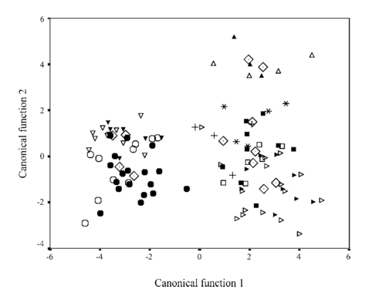
Lines of evidence?
Morphology (pre-1985)
Phenetics still common, or 1st port-of-call
e.g. Lew et al. 2006. J. Mammal. 87(2):224–237

Slide 36
Lines of evidence?
Karyotype studies,
Allozymes

Slide 37
Lines of evidence?
Karyotype studies,
Allozymes
$$$

Slide 38
Lines of evidence?
Karyotype studies,
Allozymes
⏰⏰⏰

Slide 39
Lines of evidence?
Karyotype studies,
Allozymes

Slide 40
Lines of evidence?
Karyotype studies,
Allozymes,
DNA sequencing

Slide 41
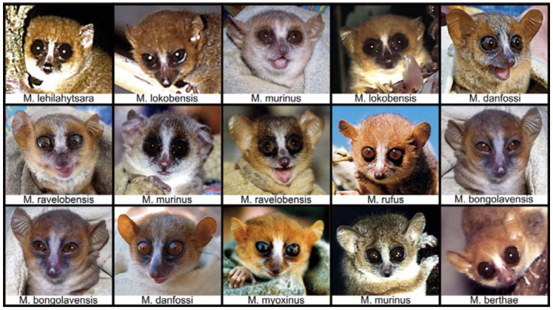
Lines of evidence?
Karyotype studies,
Allozymes,
DNA sequencing
CRYPSIS!
Fig. 2. in Zimmermann & Radespiel 2014. Evol. Anthrop.: Issues, News, and Reviews. 23(1):11–14.

Slide 42
Lines of evidence?
Karyotype studies,
Allozymes,
DNA sequencing
CRYPSIS!
TAXONOMIC INFLATION? 😅

Slide 43
$∑$ = 533

Slide 44
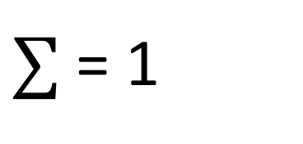
Cape → Africa → Global?
Myosorex longicaudatus
Meester & Dippenaar 1978. Annals of the Transvaal Museum. 31(4):30–42
Knysna
Morphology & geography
$∑$ = 1

Slide 45
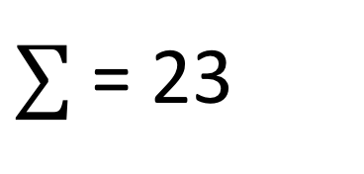
Cape → Africa → Global?
$∑$ = 23

Slide 46
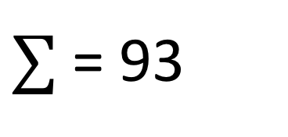
Cape → Africa → Global?
⏰
1915—2005
$∑$ = 93

Slide 47
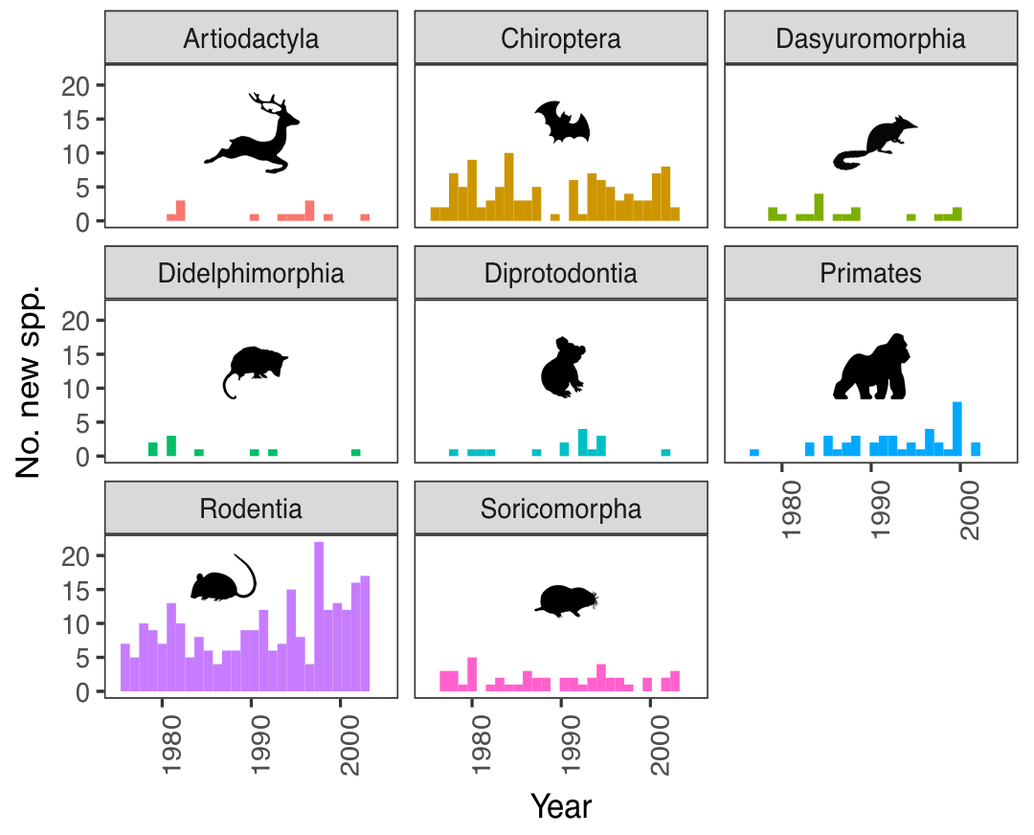
Artiodactyls

Slide 48
Dasyuromorphs, Didelphimorphs, & Diprotodonts

Slide 49
Dasyuromorphs, Didelphimorphs, & Diprotodonts
Some marsupials

Slide 50
Dasyuromorphs, Didelphimorphs, & Diprotodonts
Some marsupials
e.g. cytochrome-b (mtDNA)
Carvalho et al. 2009. Phylogeny of Thylamys (Didelphimorphia, Didelphidae) species, with special reference to Thylamys karimii

Slide 51
Primates
Fig. 2. in Zimmermann & Radespiel 2014. Evol. Anthrop.: Issues, News, and Reviews. 23(1):11–14.

Slide 52
Primates
“The increase in the number of named species […] [means] that we have increased our perception and understanding of the diversity of the primates.”
Rylands et al. 2012. International Zoo Yearbook. 46(1):11–24

Slide 53
Chiropterans

Slide 54
Rodents & Soricomorphs
cytochrome-b in rodents
Re: GSC sensu Baker & Bradley 2006 (J. of Mammal. 87(4):643–662),
Bradley & Baker 2001 (J. of Mammal. 82(4):960–973)
multi-locus work in Afro-tropical shrews
cytochrome-b, among others,
Jacquet et al. 2012. Zool. J. Linn. Soc. 166(3):672–687

Slide 55
To conclude
Molecular species delimitation is relevant to PSC/ESC/BSC
Ecologically relevant speciation processes (e.g. bats) are case-by-case
Little generality to be drawn about speciation from the alpha-taxonomic methods

Slide 56
To conclude
Genetic sequencing & PSC (or at least ESC)
Good taxonomic inflation!

Slide 57
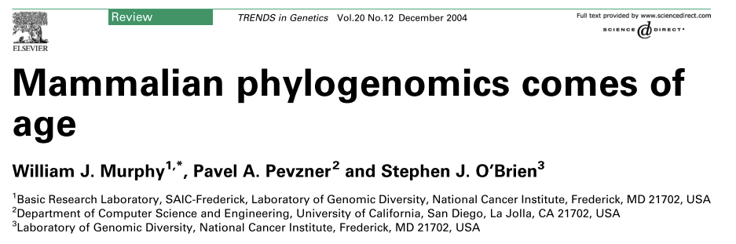
To conclude
Genomics is up-and-coming!

Slide 58
Thank you!

